Slide 1
Case Studies: Machine Learning meets Policy
Rayid Ghani

Slide 2
Machine Learning
“A computer program is said to learn from experience E with respect to some task T and some performance measure P, if its performance on T, as measured by P, improves with experience E.”

Slide 3
Types of ML tasks for Policy Problems
Description (Understand the past)
Prediction (Predict the Future)
Detection (Anomalies, Events, Patterns)
Behavior Change (Causal Inference)

Slide 4
Scoping Policy Projects
Identify Goals
Measurable, optimizing what you care about
Identify Actions
What will you do once the analysis is done?
Identify Data Sources
Data you have
Data you need
Identify Analysis/models/machine learning

Slide 5
Step 1: Determine Goals
What (measurable) goals do you have?
What are the relative priorities and tradeoffs for each goal?
Notes:
Stakeholders need to be bought in from the beginning or it won’t be effective

Slide 6
Step 2: Identify Actions that can be taken to achieve the goal
What interventions do I have access to?
What would they do differently if they had more information/knew where their interventions were most likely to be effective?
Informing these actions:
Who? (to target for each action)
What? (to say to them)
How? (to use different communication channels)
6
dsapp.uchicago.edu
@datascifellows
Notes:
Stakeholders need to be bought in from the beginning or it won’t be effective

Slide 7
Step 3: Data Sources
What relevant data sources do you have?
What data do you need?
What external data can you augment this with?

Slide 8
Step 4: Analysis
What analysis needs to be done?
What type of methods will they use?
How will the analysis be validated?

Slide 9
Examples of Case Studies
Lots of examples at http://dssg.uchicago.edu/projects

Slide 10
Case Studies

Slide 11
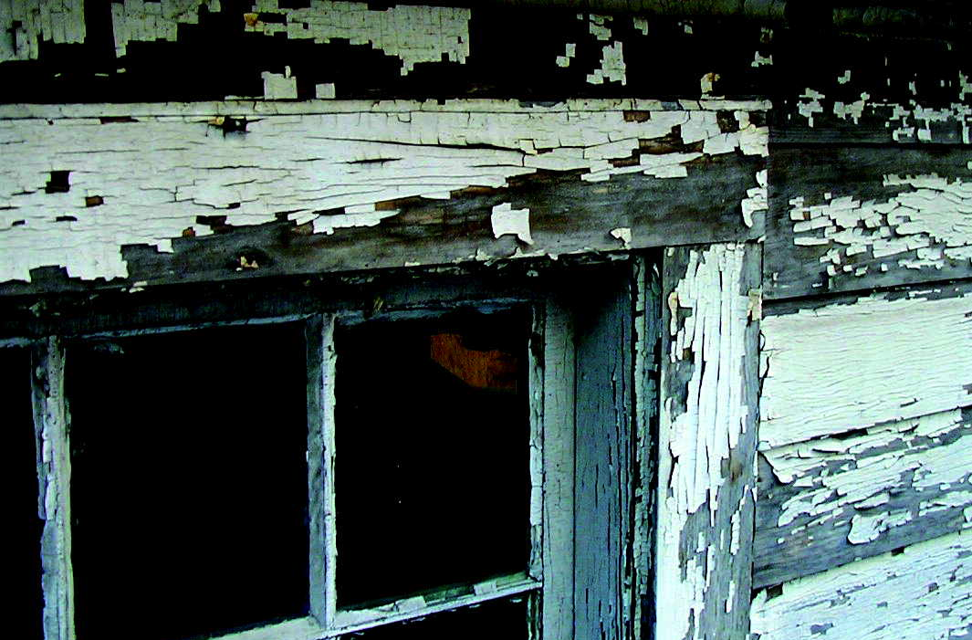

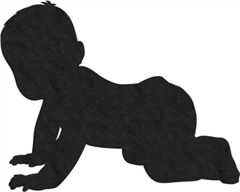
LEAD
Impaired Attention
Lack of Motor Skills
Hearing Loss
Learning Disability
Lower IQ
Memory Problems

Slide 12
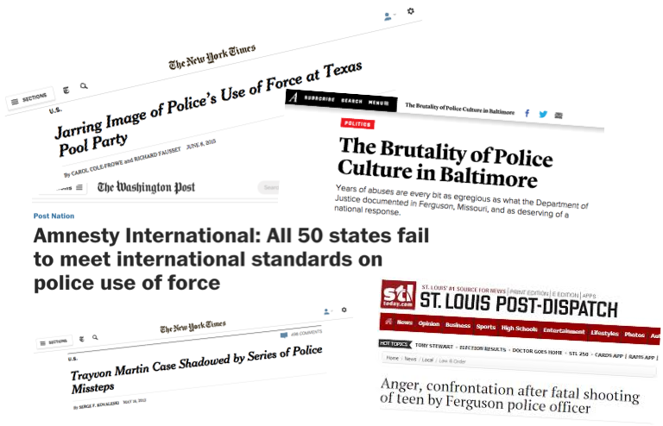

Slide 13
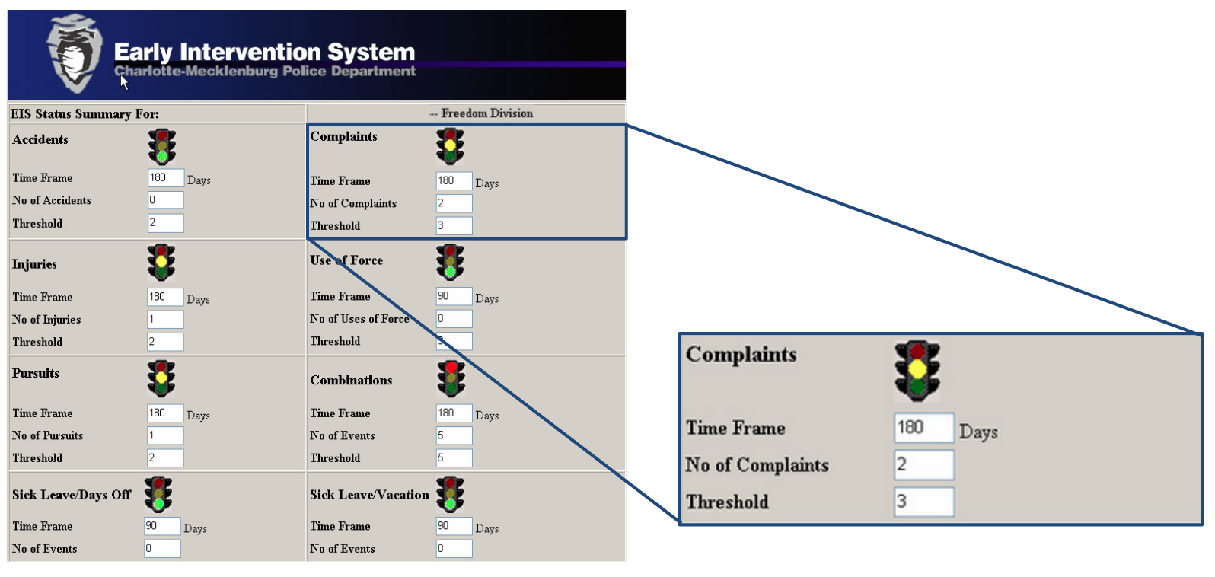

Slide 14
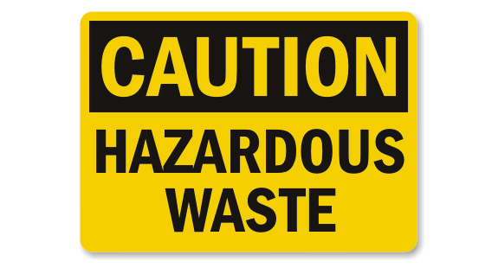

Slide 15
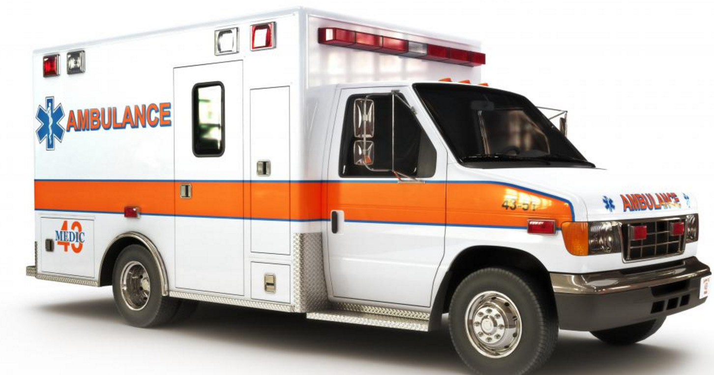

Slide 16
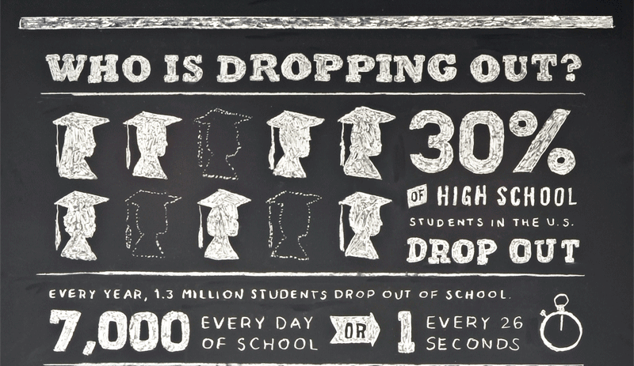

Slide 17
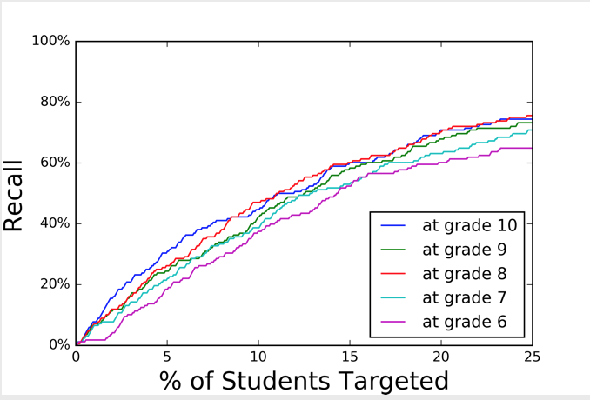
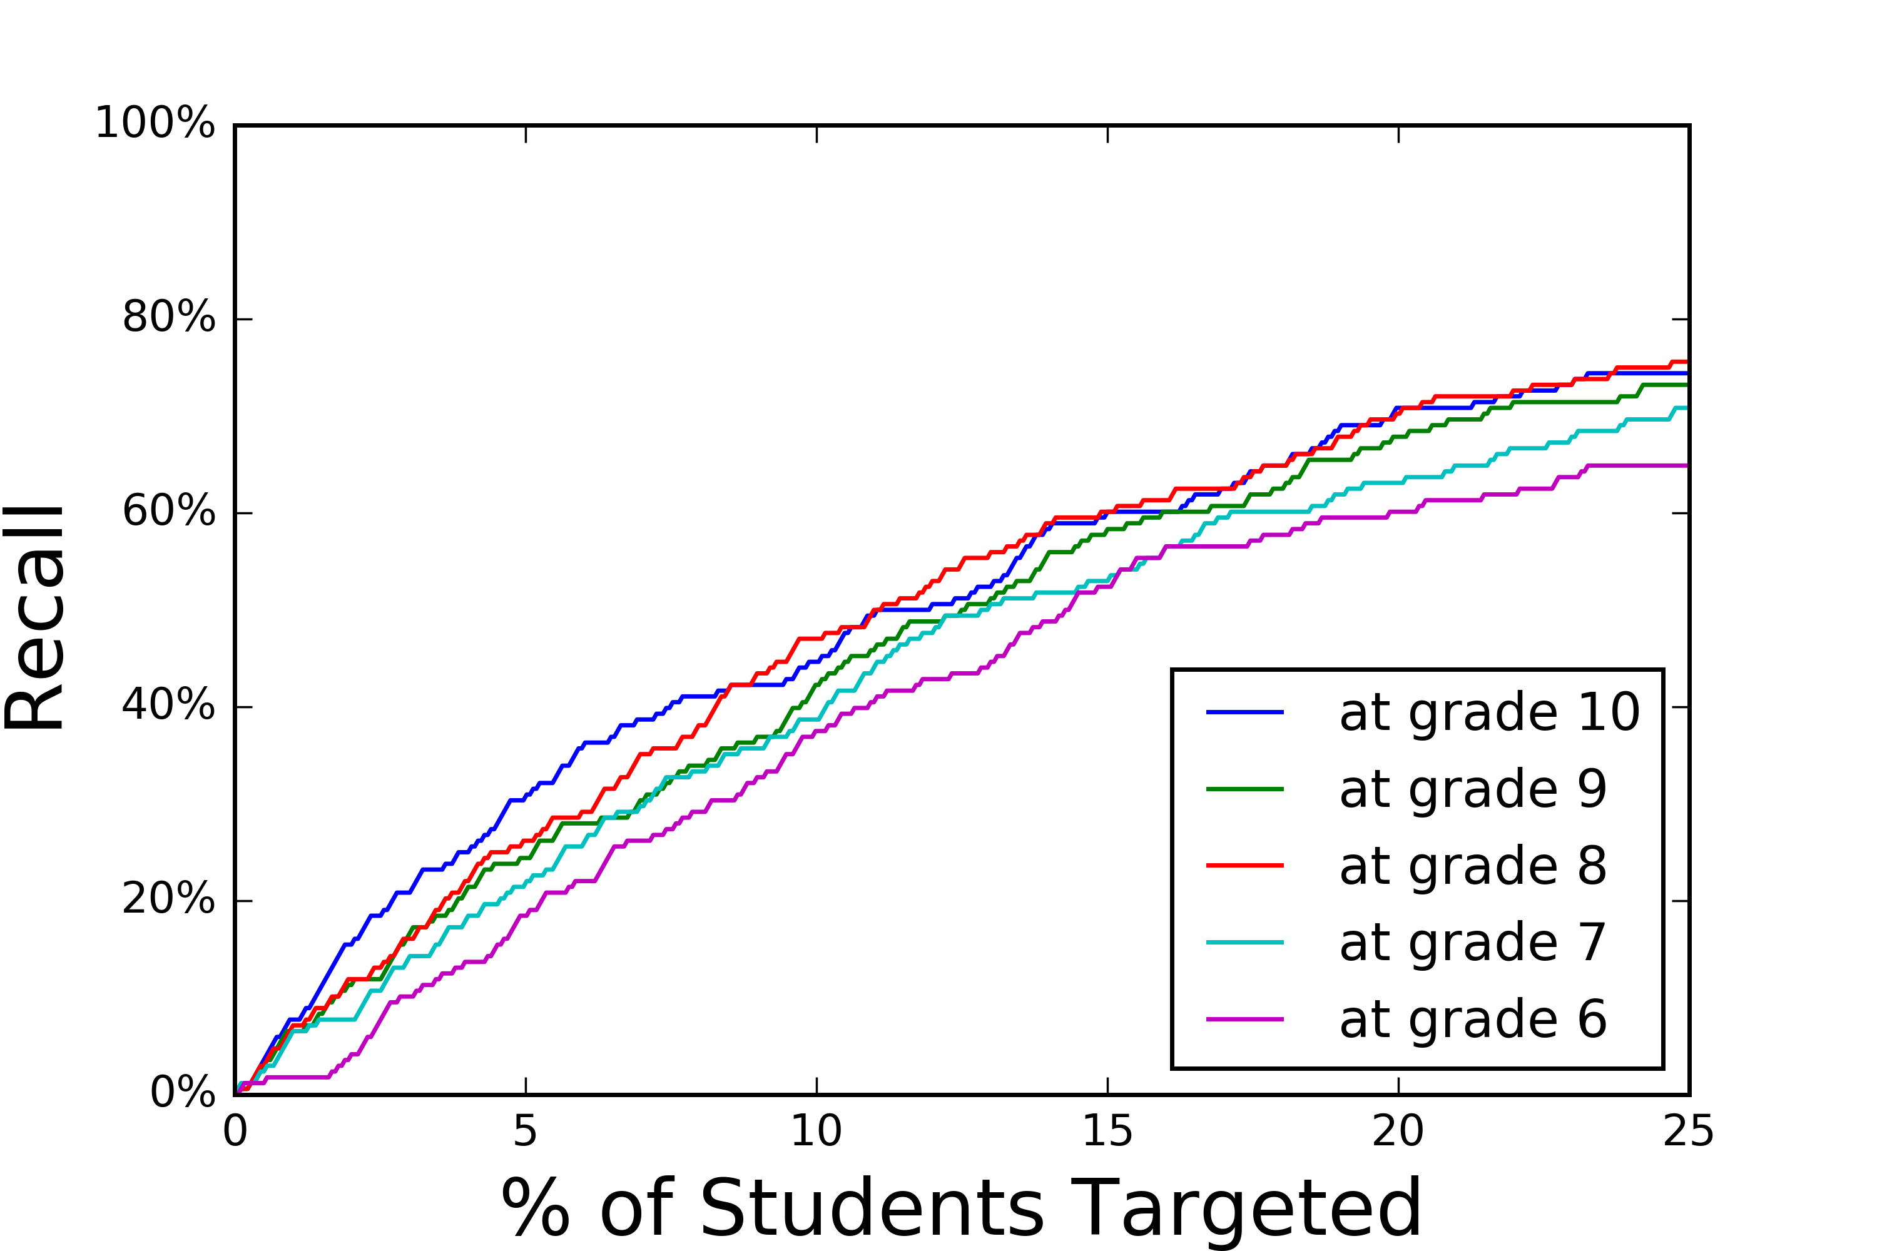
Existing System can identify 45% of the at-risk students in 10th grade
111 of 209 students at risk 125 of 209 students at risk
6 | 7 | 8 | 9 | 10 | 11 | 12

Slide 18
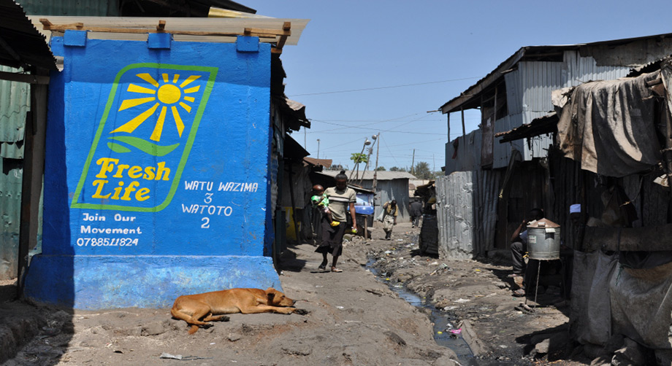
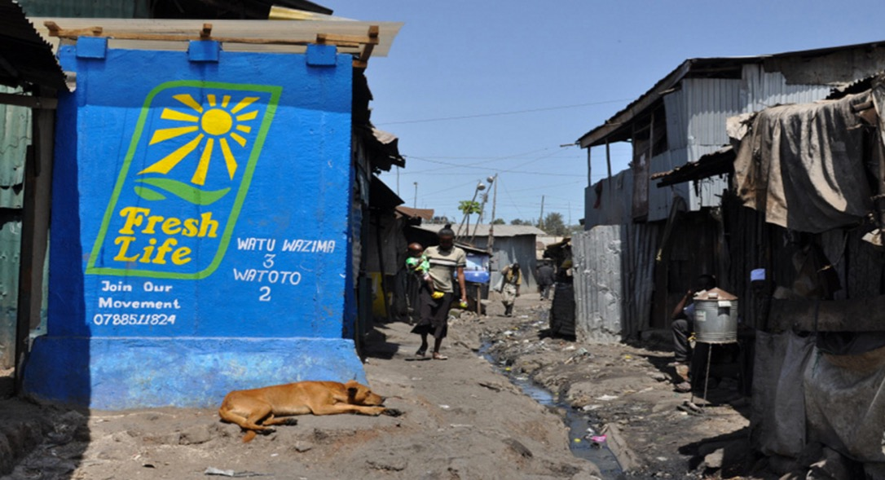
2.4 billion people don’t have sanitation facilities
946 million people defecate in the open.
2.5 million people die each year due to sanitation-related diseases.

Slide 19
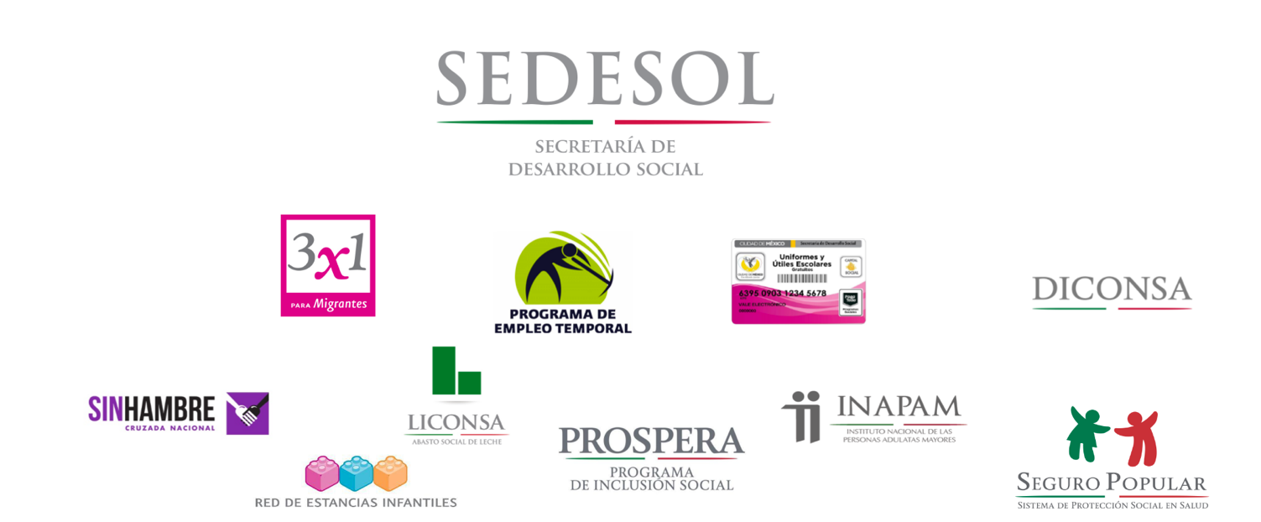
46% of the Mexican Population lives in poverty

Slide 20
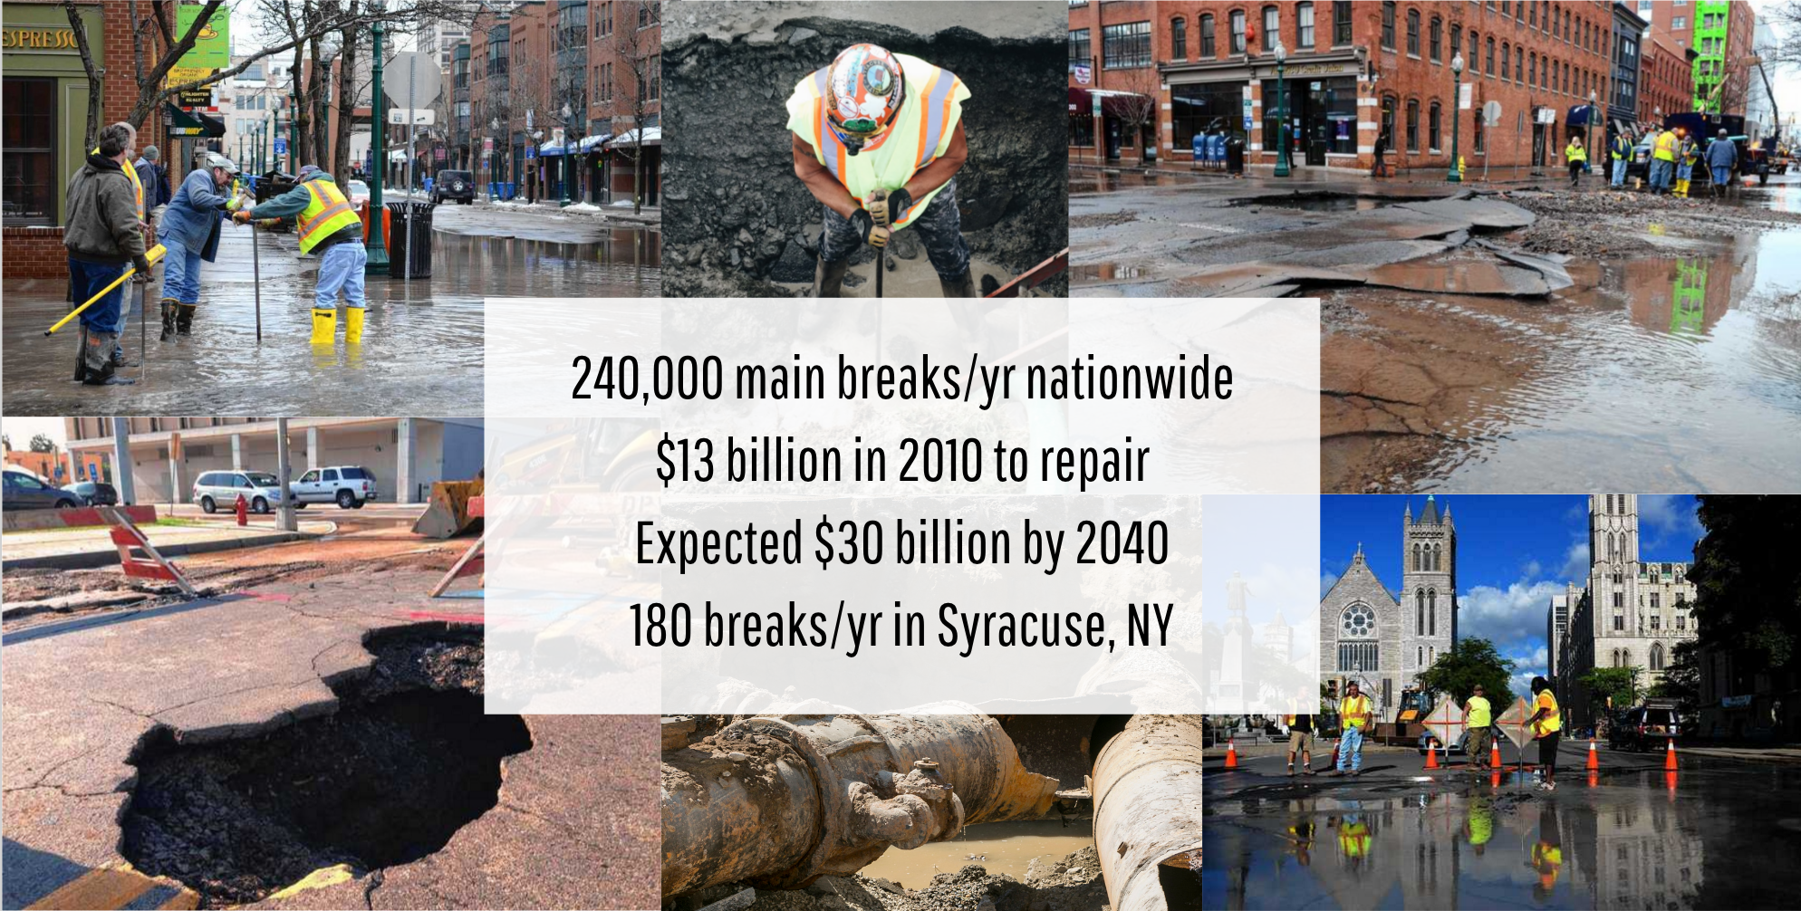

Slide 21
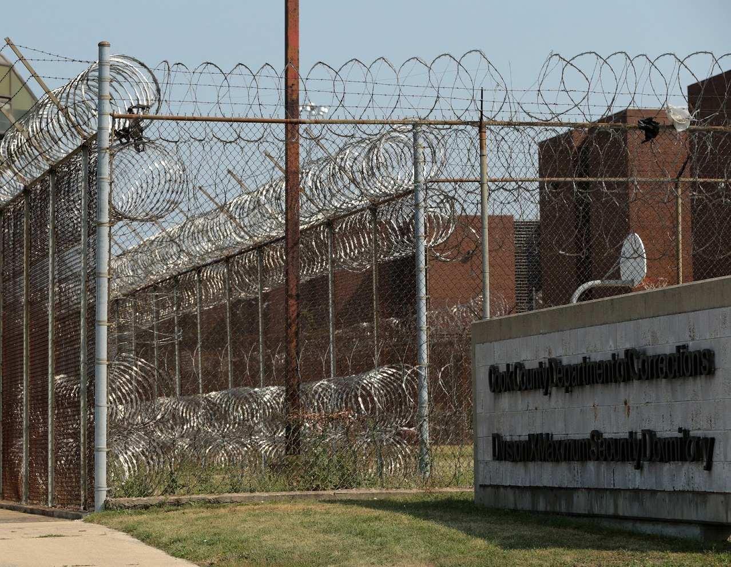
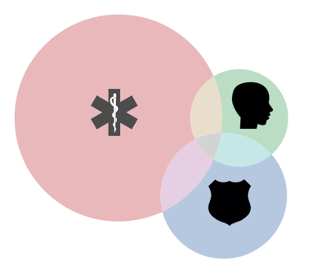
11 million people move through 3,100 Jails
$22 Billion in costs
64 % suffer from mental illness,
68% have a substance abuse disorder
44 % suffer from chronic health problems

Slide 22
